Slide 2
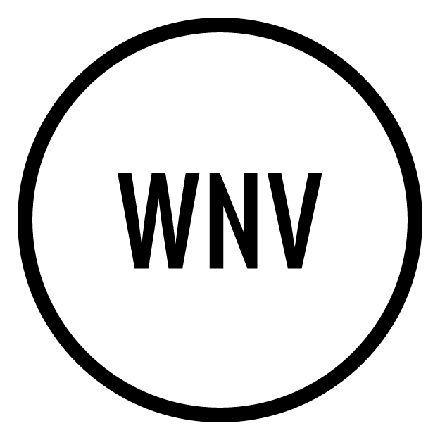
Overview
Problem Statement
Visualizing Data
Our Model
Our Proposal
Cost-Benefit Analysis
Recap and Next Steps

Slide 3
What We Know About WNV
It’s most commonly spread to humans through infected mosquitos
First cases in Chicago were reported in 2002
By the end of 2002, Illinois had counted 884 cases and 67 deaths
Notes:
By identifying the geography of appearance, the periods of time, and the source of WNV, we hope to see a pattern that we can anticipate and take action on –
We have to understand the virus (how it spreads, how long it lasts), the relationship between predictors (temperature, altitude, spray, etc), the geography (basins, hills, height) We have to account for missing variables (things that are reflected by the data, but not obvious (aka flooding)
Although we have lived through hot summers full of mosquitoes, we have limited granular understanding of what variables impact the growth of the mosquito population the most
We know that the spread of WNV, starting from the introduction in 1999, to the massive migration throughout the united states in 2002, and it’s yearly occurance, shows that WNV is not going away. The current practice, for most cities, is to spray Evergreen on it, which is a synthetic pesticide made from pyrethrins synergized with piperonyl butoxide, which enters and destroys the insects’ central nevervous system. We ask two questions: is insecticide effective to use on mosquitos, is it cost effective to administer, and is routine, seasonal administration healthy on humans?
We need to pick a modeling strategy that is flexible but precise (correctly predicts cases of wnv and not wnv)

Slide 4
Our Problem Statement
We want to reduce West Nile Virus in Chicago
We want to understand where, when and how WNV appears
Pesticide is an essential tool for mosquito population control –we want to know how best to utilize it
Notes:
By identifying the geography of appearance, the periods of time, and the source of WNV, we hope to see a pattern that we can anticipate and take action on –
We have to understand the virus (how it spreads, how long it lasts), the relationship between predictors (temperature, altitude, spray, etc), the geography (basins, hills, height) We have to account for missing variables (things that are reflected by the data, but not obvious (aka flooding)
Although we have lived through hot summers full of mosquitoes, we have limited granular understanding of what variables impact the growth of the mosquito population the most
We know that the spread of WNV, starting from the introduction in 1999, to the massive migration throughout the united states in 2002, and it’s yearly occurance, shows that WNV is not going away. The current practice, for most cities, is to spray Evergreen on it, which is a synthetic pesticide made from pyrethrins synergized with piperonyl butoxide, which enters and destroys the insects’ central nevervous system. We ask two questions: is insecticide effective to use on mosquitos, is it cost effective to administer, and is routine, seasonal administration healthy on humans?
We need to pick a modeling strategy that is flexible but precise (correctly predicts cases of wnv and not wnv)

Slide 5
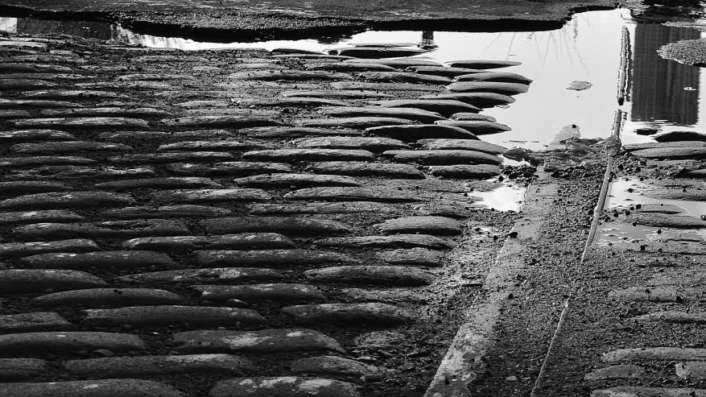
Visualizing The WNV
Problem

Slide 6
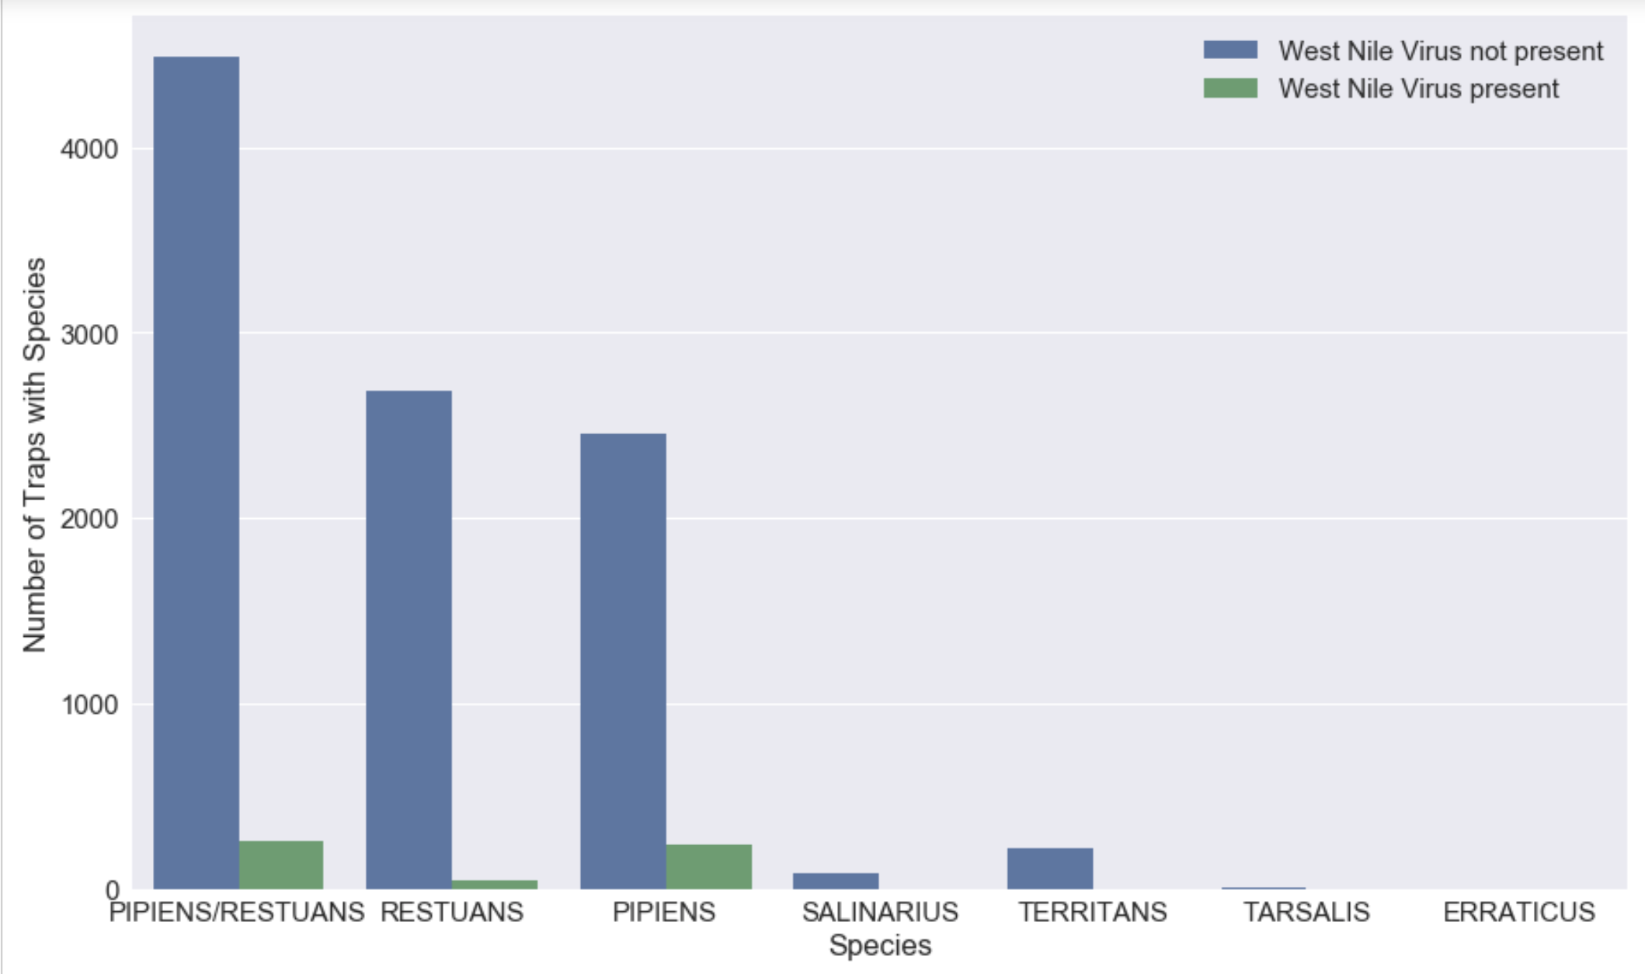
Pipiens and Restuans Carry WNV
NOTES
WNV Not Present
WNV Present
Number of Traps With Species
Pipiens/Restuans Restuans Pipiens Salinarius Territans Tarsalis Erraticus
Notes:
Pipiens and Restuans have the most WNV cases

Slide 7
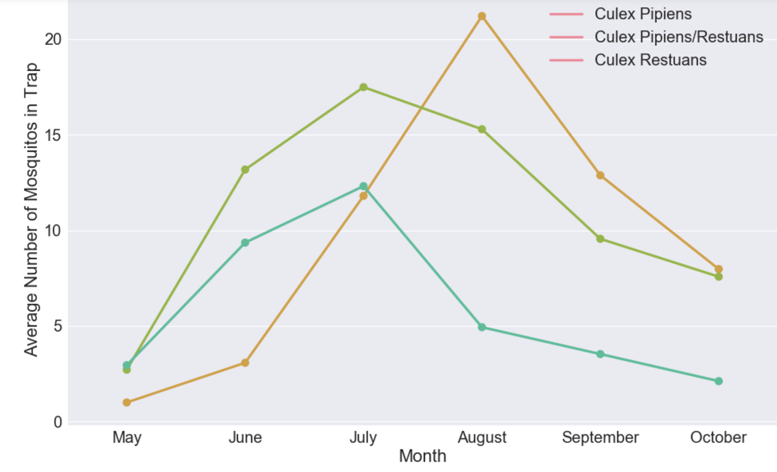
Tracking Mosquitoes Over Months

Slide 8
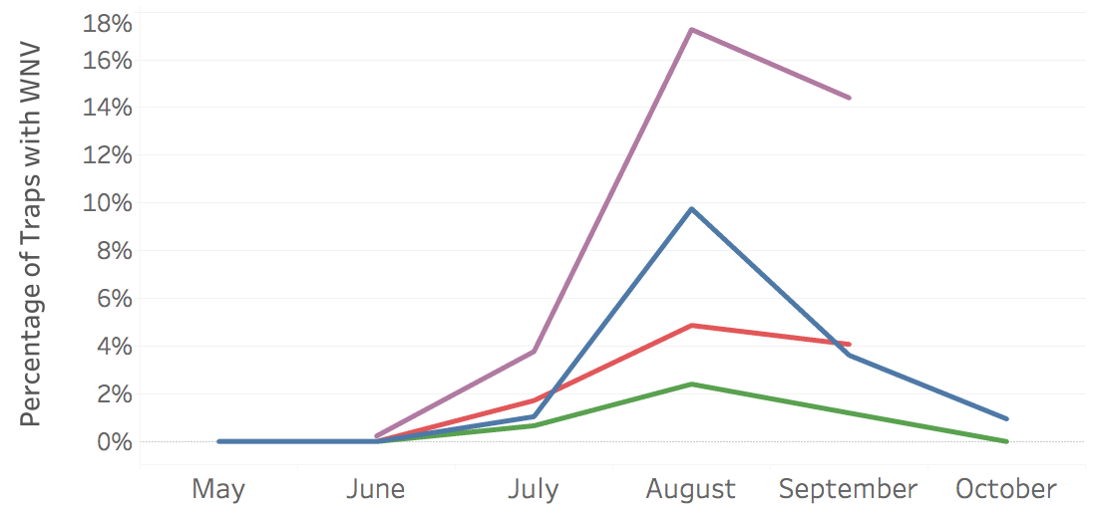
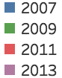
WNV Cases Peak in August
Notes:
Histogram (or line plot) showing times of the year with the most cases of WNV (we know that range is july – oct, peak in

Slide 9
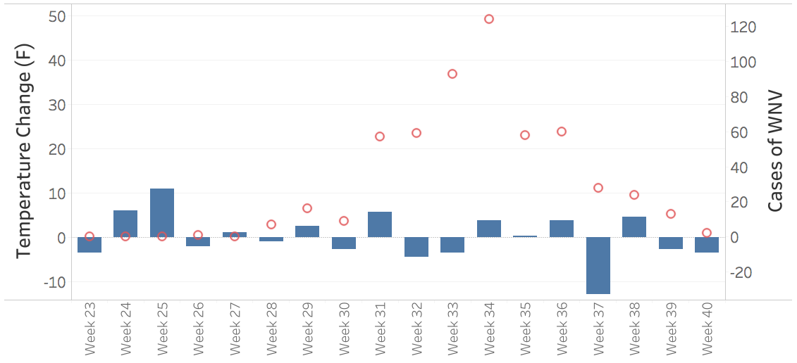
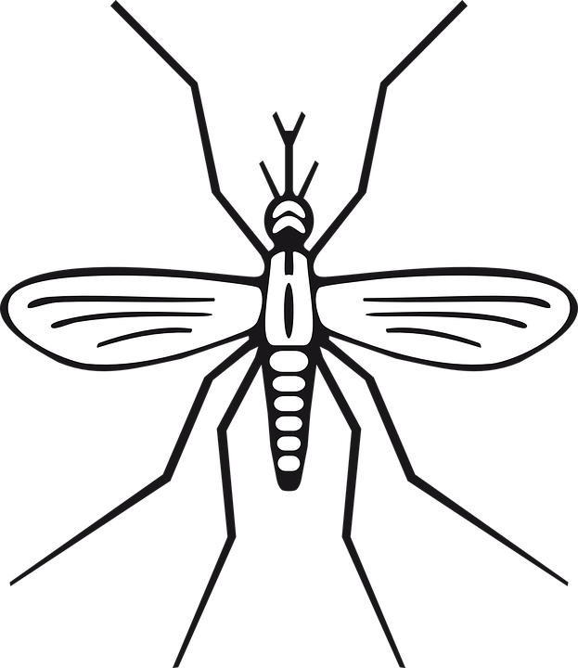
WNV Cases Rise After Elevated Temperatures
JUN JULY AUG SEP
Notes:
Temp graph: How the temperature changes (or stays consistent) from July-Oct across 4 years), vs WNV counts
Point being made: when it’s hottest, we have more counts of WNV

Slide 10
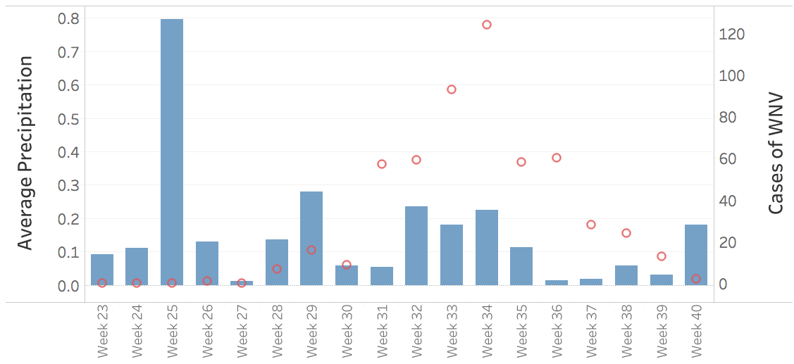
WNV Cases Rise After Elevated Rainfall
JUN JULY AUG SEP
Notes:
Temp graph: How the temperature changes (or stays consistent) from July-Oct across 4 years), vs WNV counts
Point being made: when it’s hottest, we have more counts of WNV

Slide 11
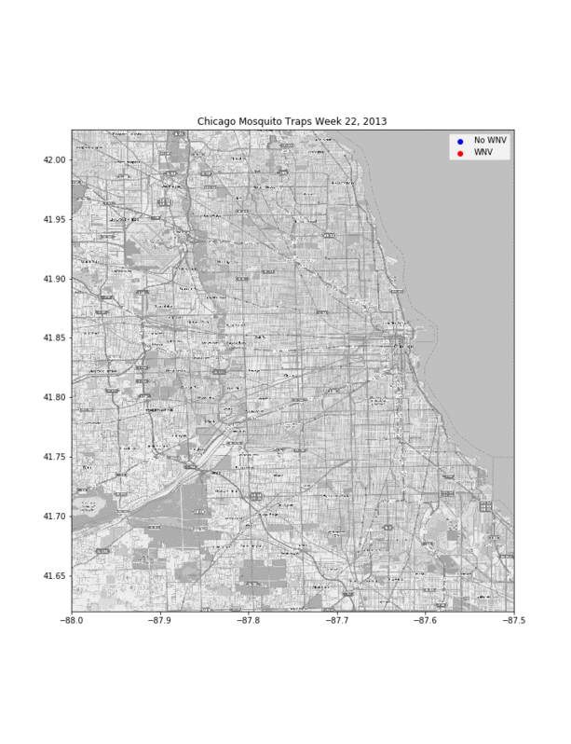
WNV Spreads From Suburbs To City Center
Notes:
Temp graph: How the temperature changes (or stays consistent) from July-Oct across 4 years), vs WNV counts
Point being made: when it’s hottest, we have more counts of WNV

Slide 12
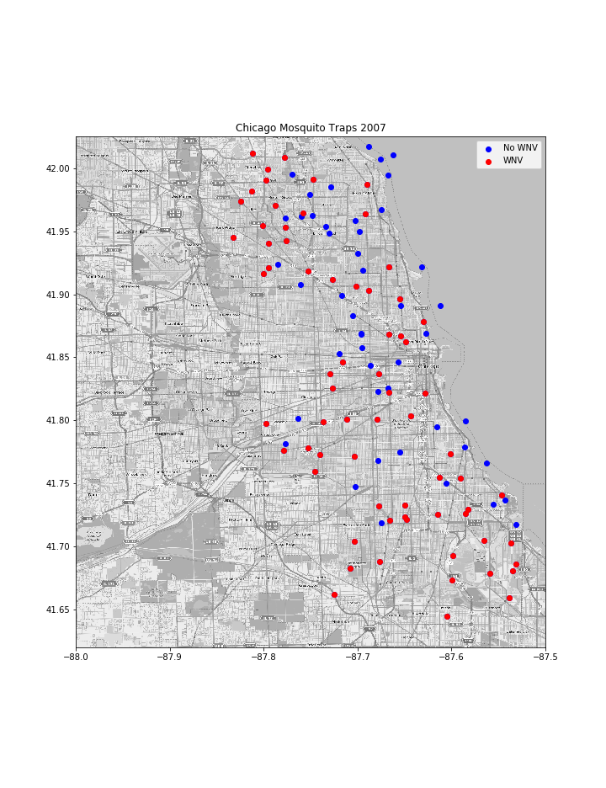
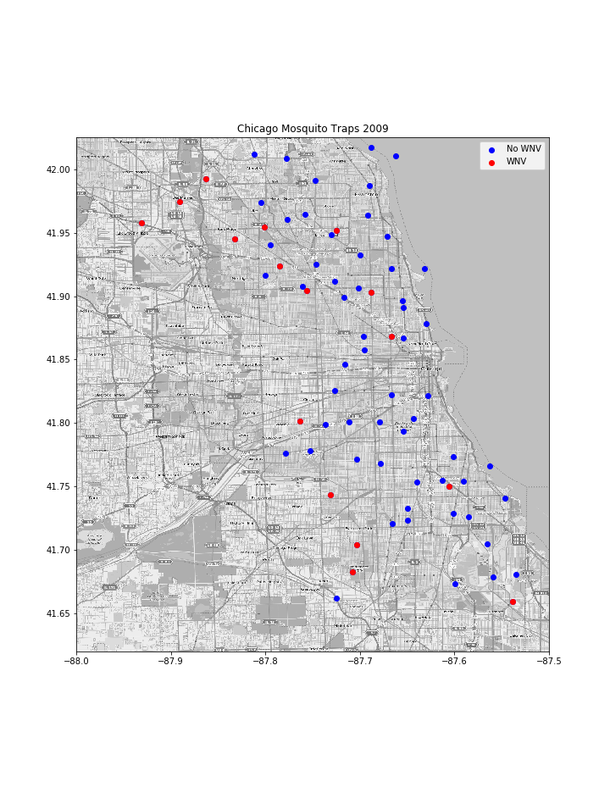
WNV Presence Over Time
OCCURRENCE
2007 .
2009 .
2007: More cases of WNV than any other year
2009: WNV reserved to the suburbs

Slide 13
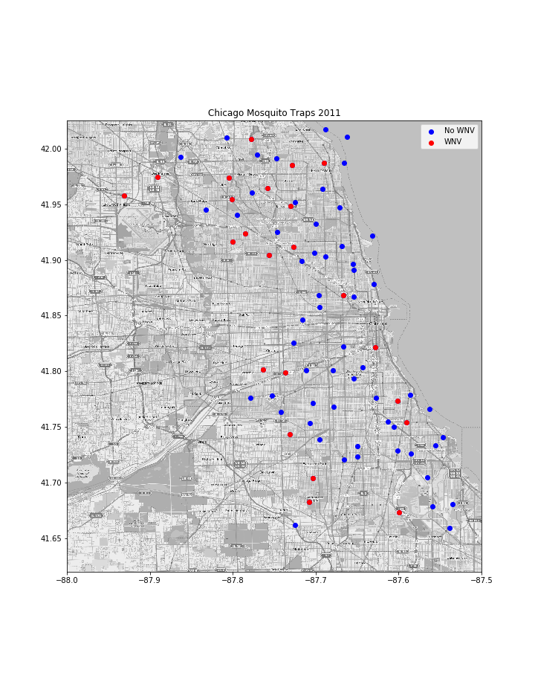
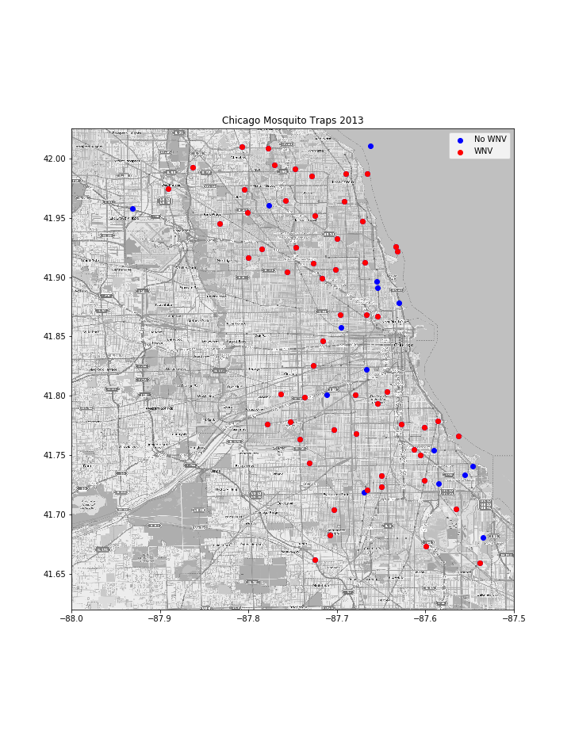
WNV Presence Over Time
OCCURRENCE
2011 .
2013 .
2011: Limited WNV cases
2013: Severe WNV presence

Slide 14
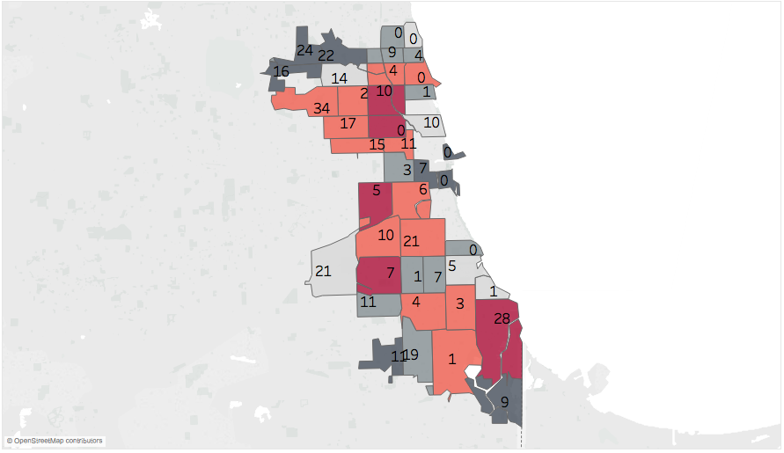
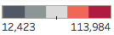
WNV Cases per Zip Code
OCCURRENCE
Pop: 98K
Several high-population zip codes have reported high WNV cases; highlighted are three zips
Pop: 74.1K
Pop: 96.2K
Population
Notes:
There’s a human factor; keep in mind what areas have the highest population

Slide 15

Our Model

Slide 16
Feature Selection
Utilized all features provided (Weather, Spray, Geo)
Preliminary feature selection
Geography - Latitude and Longitude
Weather - Precipitation, Temperature, Dew-point, Wind speeds
Spray data
Affected total mosquitos, but poor indicator of WNV
Missing for test years
Notes:
Spray data is irrelevant. Only indicates previous cases of WNV

Slide 17
Feature Engineering
Weather improvements
Temperature (3 month average, 4 week lowest)
Dew-point (4 week average)
Precipitation (3 month total)
Geospatial data
Distances from prior epicenters of outbreak added precision to model

Slide 18
Model Adjustment
Voting Classifier
Low False Positives, but higher False Negatives
XGBoost
82.5% Sensitivity (avoiding many more False Negatives)
Notes:
Voting Classifier 77.3% Kaggle
XGBoost AUC-ROC 84.2% on train-test split

Slide 19
Our Proposal

Slide 20
Our Spray Recommendations
Based on our model, we can predict when and where WNV occurs
Spray in areas with WNV based on the following criteria:
Traps that showed repeated cases of WNV counts
Traps with a high percentage of WNV per mosquito count
Areas with high human population

Slide 21


Our Model Performance
Error Matrix |  | Our Model Predictions
 |  | WNV Present | WNV Not Present
Actual West Nile Virus | WNV Present | 82.5% | 17.4%
 | WNV Not Present | 28.8% | 71.2%
Notes:
Our model detected 137 of the cases where West Nile Virus was present and missed 29 cases
We felt it was best to keep the number of missed WNV as low as possible at the expense of predicting WNV even when there was none (861 times out of 2986 cases of no WVN)

Slide 22
Consequences of Model Error
COST OF CLAIMING THERE IS WEST NILE WHEN THERE ISN’T
COST OF CLAIMING WEST NILE IS NOT PRESENT WHEN IT IS
An increase in spraying that is not needed
Population may get annoyed at having to stay inside
People spend more time outside increasing infection chance
Possibility of an epidemic if WNV isn’t controlled
Notes:
A mistake can either be a False Positive - where we claimed West Nile was present when it really wasn't - or a False Negative, which is when we claimed all was fine, when in reality West Nile was present. Given the situation, a False Negative has greater costs than a False Positive. The costs of a False Positive are that people may get more annoyed, stay in at night during the summer as opposed to going out, or perhaps use more bug spray than usual. It may also encourage city authorities to spray more than they normally would.

Slide 23
Cost-Benefit Analysis
Spraying in Chicago
$1.1 M to spray the city
Spraying reduces WNV by ⅔
(In 2016 an estimated 180 cases were prevented through spraying)
Not Spraying in Chicago
$1.9 M a year in economic damages
Each WNV infection costs the city $21 K per person
Notes:
Economic cost of West Nile
https://www.ncbi.nlm.nih.gov/pmc/articles/PMC3945683/

Slide 24
Recap
West Nile Virus is highly seasonal, becoming most prominent in July and August
Breakouts tend to originate in suburbs and spread to the center of the city
West Nile outbreaks are more severe in summers with heavy precipitation
Measures of humidity, such as dew point, also predict West Nile presence

Slide 25
Areas of Note
Areas with high percentage WNV per Mosquito:
4600 N Milwaukee Ave - 14 cases, 1% of mosquitos
6300 W 64TH St - 6 cases, 1.1% mosquitos
1300 N Laramie Ave - 7 cases, 1% mosquitos
Discontinued Traps (2007 only year):
6000 N Avondale Ave - 3.7%
6500 N Oak Park Ave - 2.6%
7900 W Foster Ave - 2.4%

Slide 26
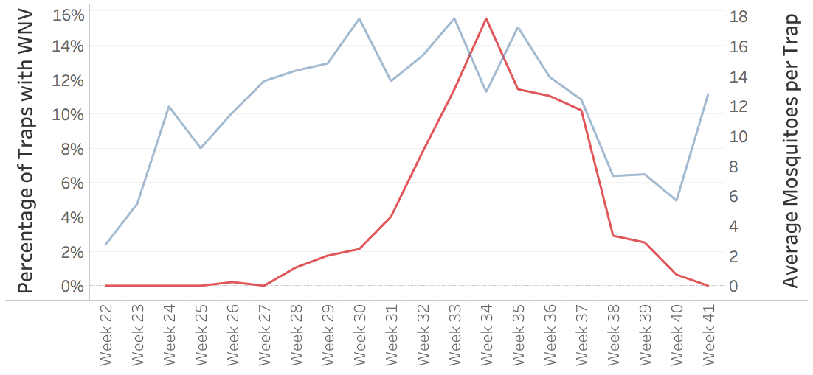
Our Window of Opportunity
% Of Traps with WNV
AVG WNV In Trap
JUN JULY AUG SEP

Slide 27
Next Steps
We recommend a mosquito vector control on July 14 and August 11th to hit mosquito populations before they grow
Tracking mosquito population growth and incorporating it into our model will greatly improve precision
Evaluate alternative tactics, such as clearing dead birds
Investigate the effectiveness of spraying insecticide with complete spray data

Slide 28
QUESTIONS?

Slide 29
THANK YOU
Dale, Diego, Matt, Natalie, & Kyle

Slide 30

Additional Insight and Info

Slide 31
A Closer Look: Data Points
Original
Longitude and Latitude
Temperature Min, Max, and Average
Average Wind Speed
Total Precipitation
Species
Dew Point
Sea Level (Station 1 and 2)
Snowfall
Wet Bulb
Station Pressure
Engineered
Distance from Chicago O’Hare Airport (miles)
Average Precipitation over 90 Days
Average Precipitation over Four Weeks
Average Temperature Over 90 Days
Average Temperature Over Four Weeks
Minimum Temperature Over Four Weeks
Average Dew Point Over Four Weeks
Average Precipitation over Four Weeks
Month
Species: Pipiens and Restuans (categorized)
Notes:
tude
0.169369
1
Latitude
0.077477
50
dist_from_ohare_MI
0.063063
30
90day_precip
0.041441
34
90day_tavg
0.041441
47
Species_CULEX TERRITANS
0.037838
40
4wk_dew
0.037838
3
st1_Tmax
0.032432
24
st2_ResultSpeed
0.032432
51
dist_from_doty_MI
0.032432
29
4wk_precip
0.030631
44
Species_CULEX RESTUANS
0.028829
39
2wk_dew
0.023423
14
st1_AvgSpeed
0.023423
45
Species_CULEX SALINARIUS
0.021622
12
st1_ResultSpeed
0.018018
42
Species_CULEX PIPIENS
0.016216
37
4wk_mintemp
0.016216
21
st2_PrecipTotal
0.014414
32
2wk_tavg
0.014414
43
Species_CULEX PIPIENS/RESTUANS
0.012613
25
st2_ResultDir

Slide 32
Vector Control
Source Reduction: the removal of mosquito breeding habitats
Habitat Modification: manipulate habitat to reduce breeding
Bio-control: introducing natural predators of mosquitoes
Larvicide: using pesticides to reduce larval populations
Adulticide: using pesticides to reduce adult populations

